Slide 1
Exploring relationships between Hospital readmission rates and mortality rates
Vema Dondeti (Bellevue University)

Slide 2
Agenda
Introduction
Selected variables
Histogram of Selected Variables
Mortality Score PMF
Mortality Score CDF
Mortality Score – Normal Distribution Fit
Scatter Plot Analysis
Hypothesis Testing
Regression Analysis
Conclusion

Slide 3
INTRODUCTION
Objective: To explore whether a relationship exists between hospital readmission rates and mortality rates.
Hypothesis: Hospitals with higher readmission rates are associated with higher mortality rates.
Notes:
Our hypothesis is that hospitals with higher readmission rates may also have higher mortality rates which indicates potential issues in care quality.
This analysis aims to reveal any correlation between these metrics to support improvements in patient outcomes.

Slide 4
SELECTED VARIABLES
Score_mortality: Mortality score, reflecting hospital mortality rates.
Score_readmission: Readmission score, indicating hospital readmission rates.
Denominator: Total cases considered in the mortality measure.
Lower Estimate: Lower confidence bound for mortality rates.
Higher Estimate: Upper confidence bound for mortality rates.
Mapping: The variables Score_mortality and Score_readmission are derived from the measurement_id values:
Score_mortality corresponds to entries with measurement_id starting with
MORT_30.
Score_readmission corresponds to entries with measurement_id starting with READM_30.
These variables are relevant as they may directly impact or represent hospital performance on mortality and readmission.
Notes:
This slide presents the selected variables for our analysis.
Score_mortality indicates hospital mortality rates and is linked to measurement_id values starting with MORT_30.
Score_readmission shows readmission rates, corresponding to measurement_id values beginning with READM_30.
The Denominator represents total cases for mortality, while the Lower Estimate and Higher Estimate provide confidence intervals.
These variables are crucial for analyzing hospital performance related to mortality and readmission rates.

Slide 5
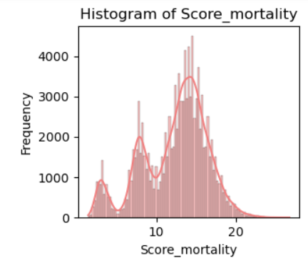
Histogram for Score_mortality
Left-skewed Distribution: More data points with lower risk scores.
Moderate Variability: Scores vary moderately from the mean (12.33) with a standard deviation of 4.12.
Presence of Outliers: 25 outliers suggest some data points with unusually high or low values.
Central Tendency: The median (13.2) and mode (14.4) suggest that the majority of scores are clustered around these values.
Range: The data spans from a minimum of 1.4 to a maximum of 26.8.
Notes:
Descriptive Statistics for Score_mortality:
Mean: 12.32888379786472
Median: 13.2
Mode: 14.4
Standard Deviation: 4.1159593173652835
Min: 1.4
Max: 26.8
Skewness: -0.5366134959996978
Tail Description: Left-skewed (negative skew) with a longer left tail.

Slide 6
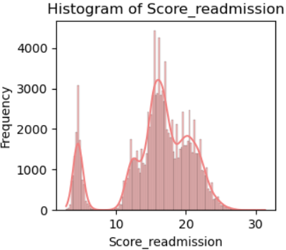
Histogram for Score_READMISSION
Left-skewed Distribution: More patients (majority) have lower readmission scores.
Moderate Variability: Readmission scores vary moderately with a standard deviation of 5.09.
Potential Outliers: Some patients (likely a small number) have unusually low readmission scores (below 2.9).
Central Tendency: The mean (15.87), median (16.4), and mode (15.5) are relatively close.
Notes:
Descriptive Statistics for Score_readmission:
Mean: 15.874735743412382
Median: 16.4
Mode: 15.5
Standard Deviation: 5.096920563507814
Min: 2.9
Max: 31.3
Skewness: -0.8758585231865714
Tail Description: Left-skewed (negative skew) with a longer left tail.

Slide 7
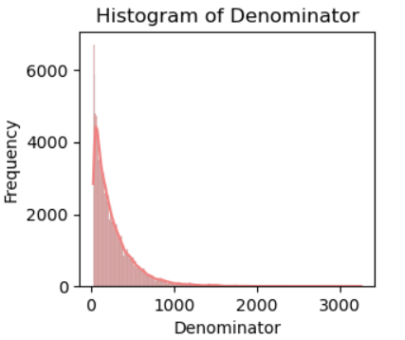
Histogram for DENOMINATOR
Right-skewed Distribution: Most values are concentrated on the lower end.
High Variability: Values vary widely with a standard deviation of 261.22.
Potential Outliers: A few very large values pull the mean upwards.
Central Tendency: The mode (34.0) suggests that many values are clustered around this lower value.
Notes:
Descriptive Statistics for Denominator:
Mean: 265.3421669482455
Median: 184.0
Mode: 34.0
Standard Deviation: 261.21930483424745
Min: 25.0
Max: 3255.0
Skewness: 2.49272987333178
Tail Description: Right-skewed (positive skew) with a longer right tail.

Slide 8
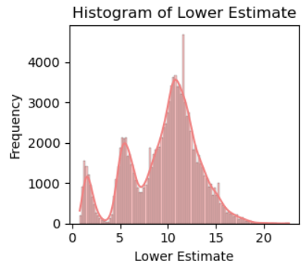
Histogram for LOWER ESTIMATE
Left-skewed Distribution: Most lower estimates are concentrated on the higher end.
Moderate Variability: Lower estimates vary moderately with a standard deviation of 3.62.
Presence of Outliers: 46 lower estimates are unusually low.
Central Tendency: The mode (10.8) suggests that many lower estimates are clustered around this value.
Notes:
Descriptive Statistics for Lower Estimate:
Mean: 9.595702015868662
Median: 10.3
Mode: 10.8
Standard Deviation: 3.6244054175160763
Min: 0.8
Max: 22.6
Skewness: -0.4356619694966962
Tail Description: Left-skewed (negative skew) with a longer left tail.

Slide 9
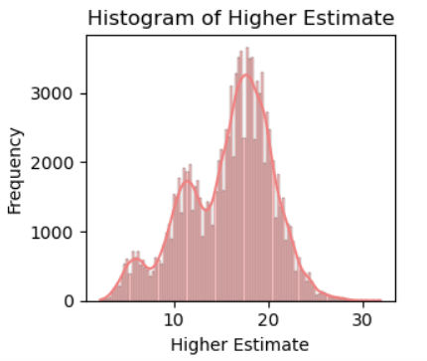
Histogram for HIGHER ESTIMATE
Left-skewed Distribution: Most higher estimates are concentrated on the higher end.
Moderate Variability: Higher estimates vary moderately with a standard deviation of 4.63.
Presence of Outliers: 30 higher estimates are unusually low.
Central Tendency: The mode (17.7) suggests that many higher estimates are clustered around this value.
Notes:
Descriptive Statistics for Higher Estimate:
Mean: 15.753474918843375
Median: 16.6
Mode: 17.7
Standard Deviation: 4.626379986426984
Min: 2.2
Max: 31.9
Skewness: -0.45377788434010224
Tail Description: Left-skewed (negative skew) with a longer left tail.

Slide 10
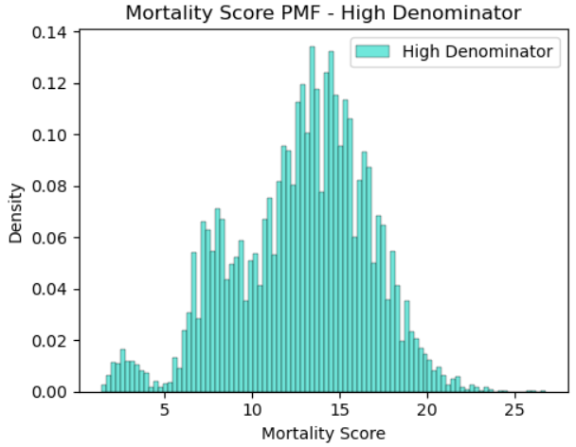
High Denominator Mortality Score PMF
Peak around 15: Most cases have a mortality score around 15.
Right-Skewed: A few cases have significantly higher mortality scores.
Moderate Variability: Mortality scores are moderately spread out.
Notes:
Analyzed the Probability Mass Function (PMF) for mortality scores, comparing hospitals categorized by high and low denominators.
This segmentation helps us investigate how the volume of cases impacts mortality rates.

Slide 11
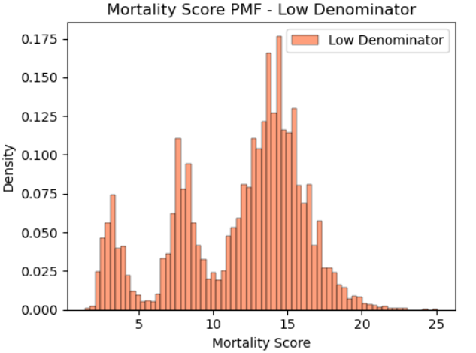
Low Denominator Mortality Score PMF
Peak around 15: Similar to high-denominator, most cases peak around 15.
Right-Skewed: A few cases have significantly higher mortality scores.
Lower Variability: Mortality scores are less spread out compared to high-denominator cases.
Notes:
Analyzed the Probability Mass Function (PMF) for mortality scores, comparing hospitals categorized by high and low denominators.
This segmentation helps us investigate how the volume of cases impacts mortality rates.

Slide 12
Comparison of High and Low Denominator Mortality Score PMFs
Similar Peak: Both distributions peak around a mortality score of 15, suggesting a similar central tendency.
Similar Skewness: Both distributions are right-skewed, indicating the presence of high-scoring outliers.
Variability Difference: The high-denominator group exhibits more variability in mortality scores compared to the low-denominator group.
Potential Implications:
High-denominator cases might represent a more heterogeneous population with a wider range of risk factors and outcomes.
Low-denominator cases might be more homogeneous, potentially due to stricter inclusion criteria or specific patient characteristics.

Slide 13
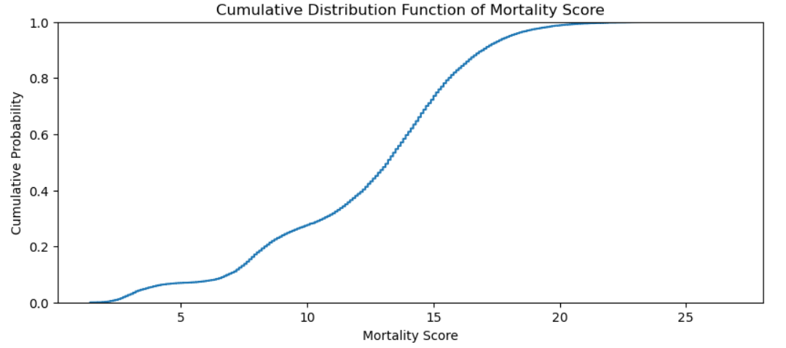
Cumulative Distribution Function (CDF) for Mortality Score
Key Observations:
S-Shaped Curve: Characteristic of cumulative distribution functions.
Increasing Trend: Higher mortality scores correlate with increased cumulative probability, showing more hospitals have lower scores.
Varying Steepness: Steeper sections indicate higher concentrations of hospitals in specific mortality score ranges.
Concentration of Low-Performing Hospitals: Significant initial rise indicates many hospitals with low mortality scores.
Long Tail: Longer tail reflects fewer hospitals with significantly higher mortality scores.
Relation to Hypothesis:
The CDF supports the hypothesis that a small number of hospitals with higher mortality scores might be associated with higher readmission rates. The clustering of hospitals with low mortality scores suggests that most hospitals perform relatively well, while a few outliers may drive the overall trend.
Notes:
The CDF illustrates that low mortality scores are common among hospitals, while higher scores are less frequent.
This aligns with our hypothesis, suggesting that high readmission rates may be associated with these fewer high-mortality cases.

Slide 14
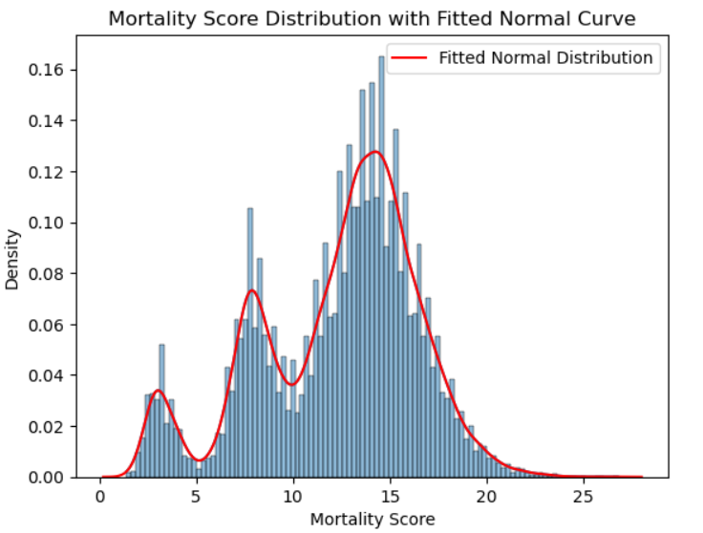
Mortality Score Distribution with a Fitted Normal Curve
Non-Normal Distribution: The mortality score histogram shows a right-skewed pattern, deviating from normality with a longer tail on the high end.
Fitted Normal Curve: The normal curve does not fit well with the empirical data, highlighting the non-normal nature of the distribution.
Potential Outliers: The right tail indicates some hospitals have significantly higher mortality scores.
Normality Assumption: Tests assuming normality (e.g., t-tests, ANOVA) may not be valid for this dataset.
Non-parametric Tests: Utilize non-parametric tests that do not require normality assumptions for analysis.
Notes:
The non-normal distribution of mortality scores suggests caution in applying parametric tests and highlights the need for alternative statistical approaches and potential transformations.

Slide 15
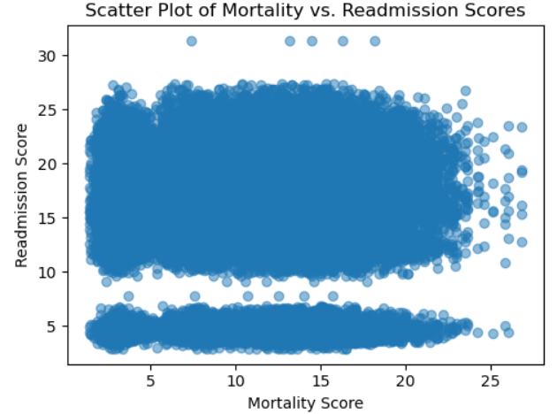
Scatter Plot Analysis - Mortality Score vs. Readmission Score
Weak Positive Correlation: The correlation coefficient of 0.0044 indicates a negligible linear relationship between mortality and readmission scores.
Potential Non-linear Relationship: A more detailed analysis might reveal non-linear patterns in the data.
Shared Risk Factors: Hospitals with higher mortality rates might also have underlying factors contributing to increased readmission rates.
Quality of Care: Poor quality of care could be a common factor influencing both mortality and readmission.
Notes:
Correlation vs. Causation: While correlation indicates a relationship, it does not imply causation.
Correlation between Mortality and Readmission Scores: 0.004479555026011939

Slide 16
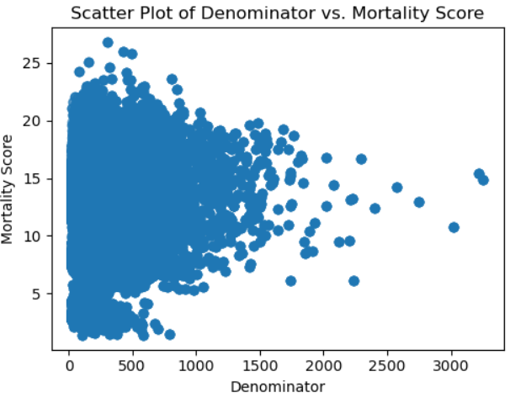
Scatter Plot Analysis - Denominator vs. Mortality Score
Weak Positive Correlation: The correlation coefficient of 0.1361 indicates a weak positive linear relationship between the denominator and mortality score.
Clustering: The data points are clustered in a specific region, suggesting that most hospitals have a relatively low denominator and a moderate mortality score.
Outliers: There are a few outliers with high denominator values and relatively high mortality scores.
Notes:
Correlation vs. Causation: While correlation indicates a relationship, it does not imply causation.
Correlation between Denominator and Mortality Score: 0.1361601086513735

Slide 17
Hypothesis Testing Using Permutation Test
Overview of the Test
Hypothesis Statement: Do hospitals with higher readmission rates also have higher mortality rates?
Test Method: Permutation Test
Why Choose the Permutation Test?
Non-parametric: Does not assume normality of data distributions.
Flexibility: Suitable for comparing means of two groups, such as high and low readmission rates.
Robustness: Less sensitive to outliers compared to traditional tests.
Observed Results
Observed Difference in Means: 0.0367
P-value from Permutation Test: 0.1346
Interpretation
P-value: 0.1346 indicates no statistically significant difference in mortality scores between hospitals with high and low readmission rates (not significant at Alpha levels 0.05 or 0.01).
Conclusion: Insufficient evidence to reject the null hypothesis; no significant relationship between readmission and mortality rates.
Notes:
Observed difference in means: 0.036703755709734054
P-value from permutation test: 0.13

Slide 18
Regression Analysis: Mortality Score and Readmission Score
Simple linear regression Model:
Dependent Variable: Readmission Score
Independent Variable: Mortality Score
Key Findings:
R-squared: 0.000 – The model explains almost no variance in the readmission score.
Adjusted R-squared: 0.000 – Confirms the model's poor fit.
Intercept: 15.8063 – Estimated readmission score when the mortality score is 0.
Score_mortality: 0.0055 – A one-unit increase in mortality score predicts a 0.0055 increase in the readmission score, holding other factors constant.
Implications:
There is no significant linear relationship between mortality and readmission scores.
The mortality score is a weak predictor of readmission.
Additional factors should be included in future analyses for better accuracy.
Notes:
Conducted simple linear regression to quantify the impact of changes in the mortality score on the readmission score.
R-squared: 0.000
Adjusted R-squared: 0.000
p-value for Score_mortality: 0.132

Slide 19
Conclusion
No Significant Relationship: The hypothesis that hospitals with higher readmission rates also have higher mortality rates is not supported by the data.
Model Limitations: Regression analysis indicates a lack of predictive power; the model explains almost none of the variance in readmission scores.
Need for Additional Variables: Other factors, such as patient demographics and hospital characteristics, may play a crucial role in influencing readmission rates and should be considered in future analyses.
Complex Relationships: The interaction between mortality and readmission may be non-linear, necessitating further exploration of different modeling approaches.

